Slide 1

Commodity Procurement Strategy Optimization Using Quantum Devices CDL Quantum Hackathon 2019
PiQAOAsso
Alvaro Ortega Gonzalez
Will Pol
Fazal Mahmood
Alex Luna

Slide 2
Agenda
Problem Exploration
Problem Statement
Quantum Solution – D-Wave
Quantum Solution - Rigetti
Quantum Solution – Xanadu
Conclusion

Slide 3

Problem Exploration
Coca Cola’s Annual High Fructose Corn Syrup Supply Allocation

Slide 4




Problem Exploration
Coke’s procurement team needs to allocate its ~$1.2B (USD) HFCS spend for its plants to HFCS suppliers for the 2020 calendar year
Grain processing companies (below) supply HFCS to Coke’s bottling network
Coke wants to maximize supplier competitiveness in franchise regions in order to maximize allocation leverage against suppliers to minimize supplier price offerings in the negotiation

Slide 5
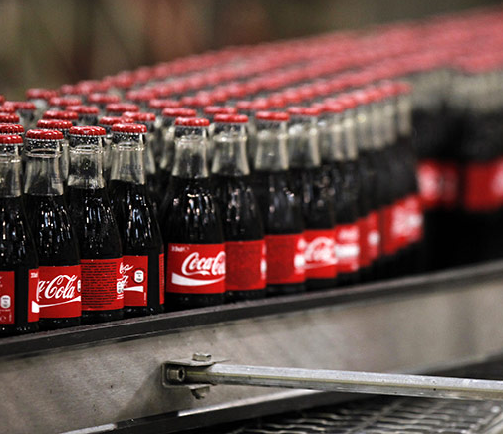
Problem Statement
Coca Cola’s Annual High Fructose Corn Syrup Supply Allocation

Slide 6
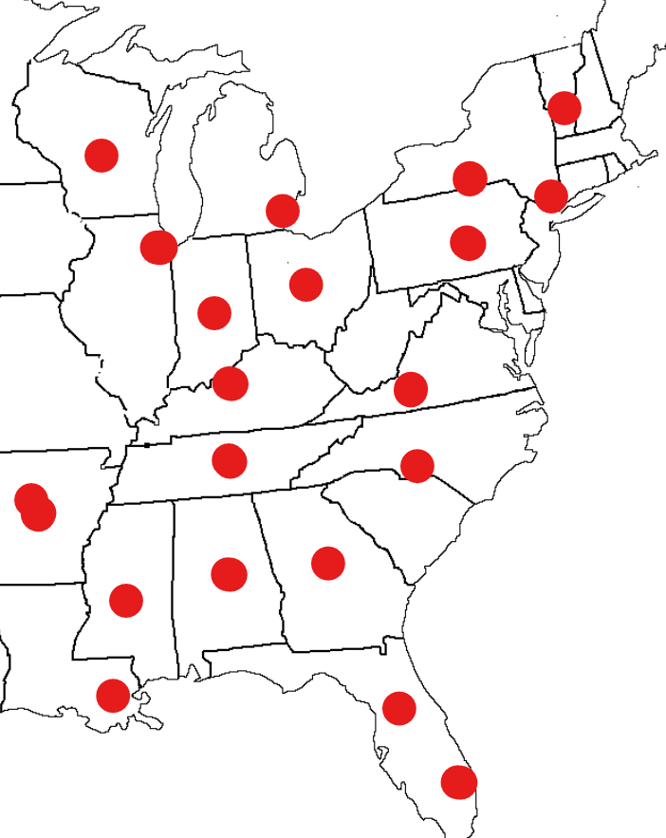













Problem Statement
Objective:
Maximize price leverage against suppliers by preventing regional supply dominance by any single supplier
Assumptions:
Competitiveness is maximized when suppliers do not supply clusters of bottlers in a region
Coke focusing only on Eastern US Bottling Plants
Constraints:
5 suppliers
21 plants
6 independently owned bottling franchise regions
Eastern US Coke Bottlers

Slide 7
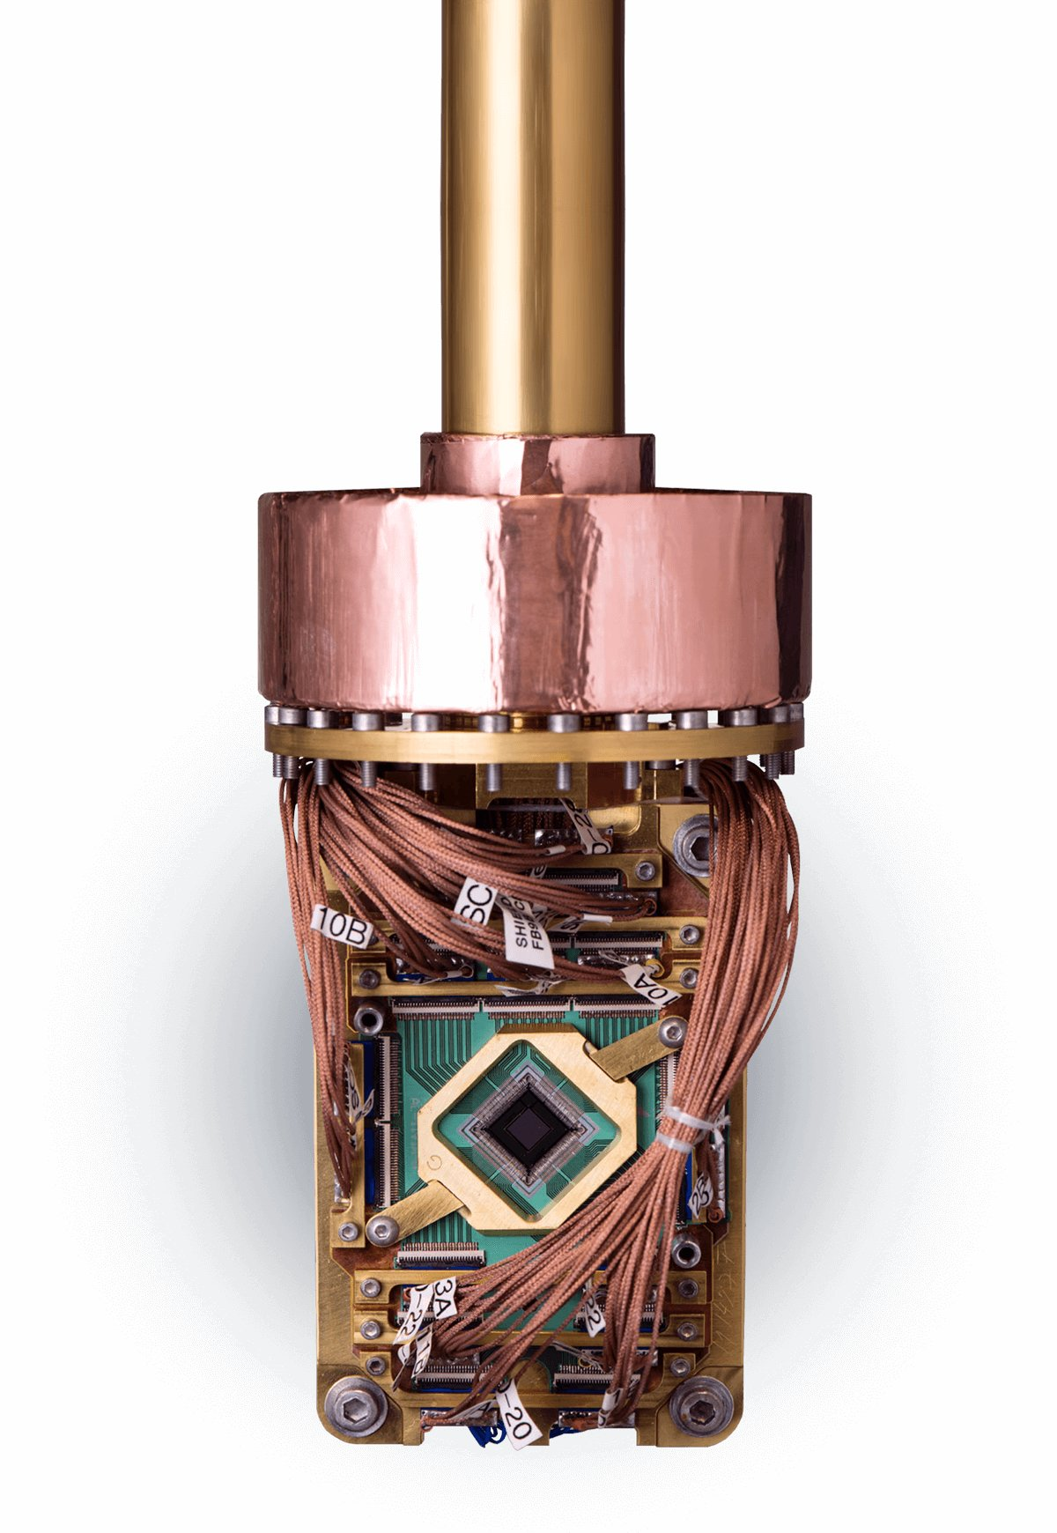
Quantum Solution: D-Wave
Coca Cola’s Annual High Fructose Corn Syrup Supply Allocation

Slide 8
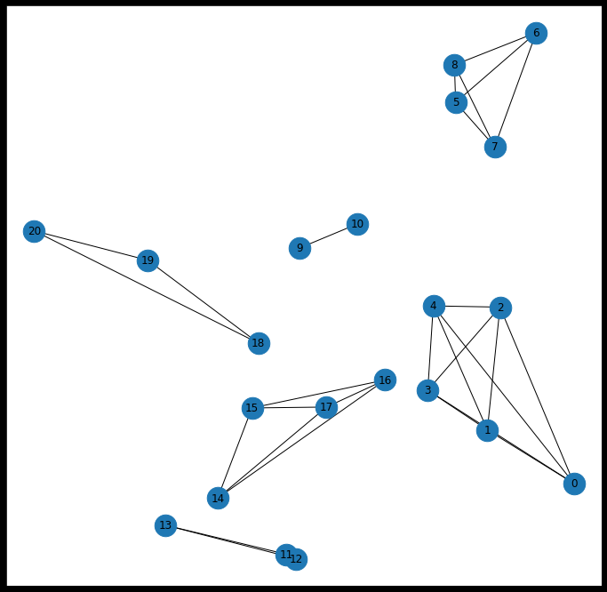
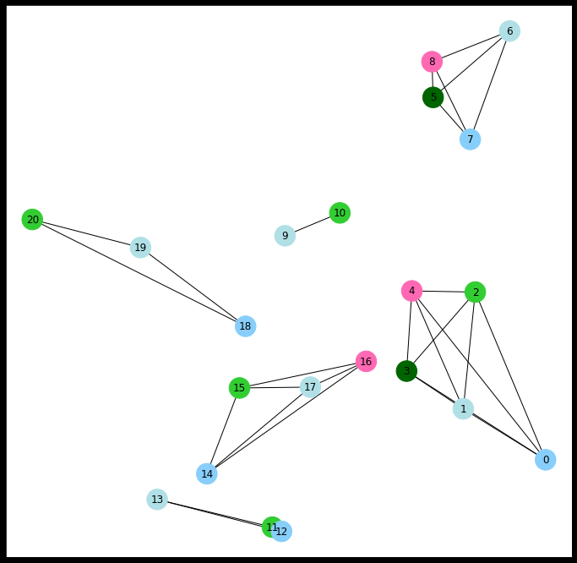
Quantum Solution: D-Wave
QUBO development
Difference in performance between hardware & QBsolv
Network Pre-Optimization
Optimized Network

Slide 9

Quantum Solution: Rigetti
Coca Cola’s Annual High Fructose Corn Syrup Supply Allocation

Slide 10
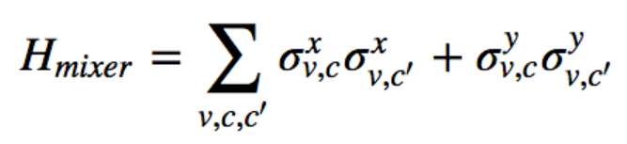
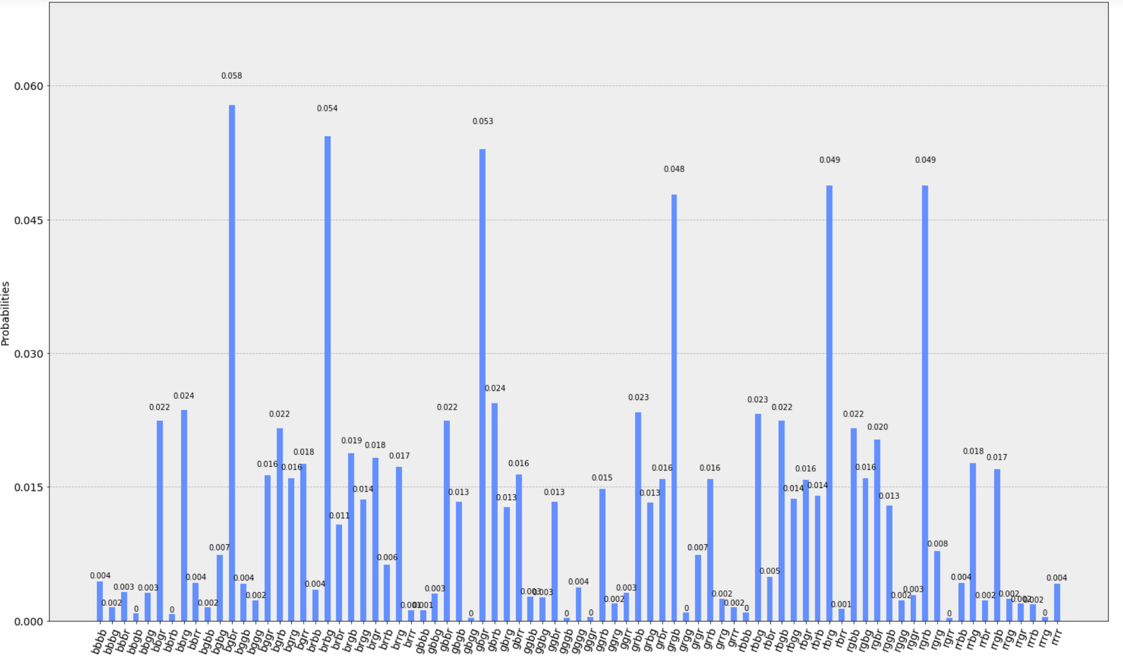
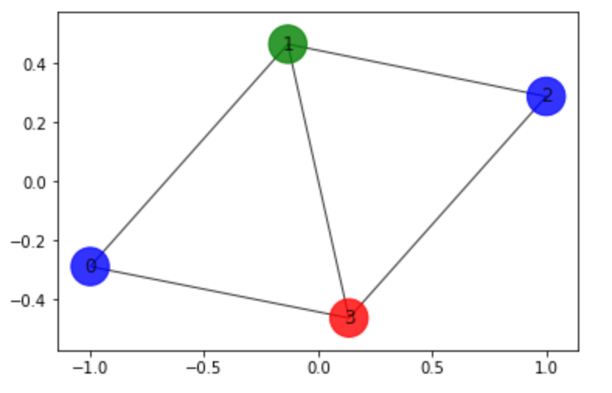
Quantum Solution: Rigetti
QAOA
Can run small problems
With smart choice of mixer, trade-off between qubit count & size of solution space for constrained problems

Slide 11

Quantum Solution: Xanadu
Coca Cola’s Annual High Fructose Corn Syrup Supply Allocation

Slide 12
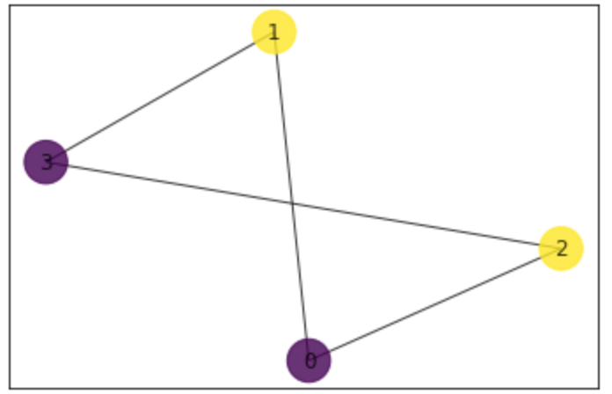
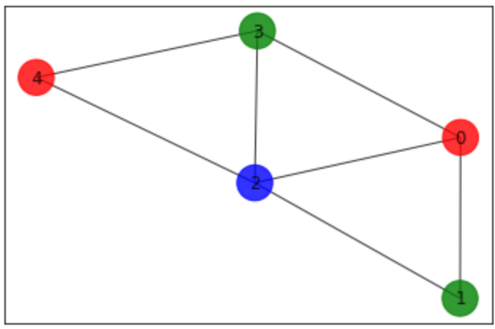
Quantum Solution: Xanadu
Sample subgraphs using GBS
Can run highly structured problems
Colors dense parts of graphs

Slide 13

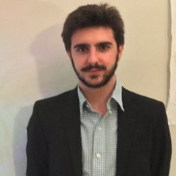


Conclusion
Solved an instance of the graph coloring problem using Xanadu’s Gaussian Boson Sampling
Utilized 3 different quantum hardware architectures to solve a real world business problem
Alvaro Ortega Gonzalez
Will Pol
Fazal Mahmood
Alex Luna

